Slide 1
JAVA ARCHITECTURE
Topics:
What is java architecture?
Components of java
By sowndharya

Slide 2
What is Java Architecture?
Java architecture combines the process of compilation and interpretation
It defines all the processes involved in creating a java program

Slide 3
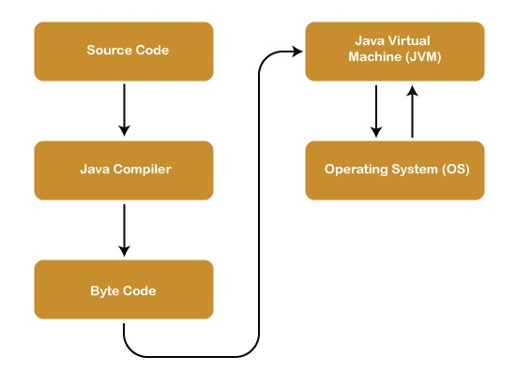

Slide 4
Components of java architecture:
The java architecture includes the three main components
JVM(Java Virtual Machine)
JRE(Java Runtime Environment)
JDK(Java Development Kit)

Slide 5
JVM
Jvm’s main task is to convert byte into machine code.
Java virtual machine has its own architecture.
Class loader
Class method area
Execution engine

Slide 6
Heap memory
The area is a part of the jvm memory and is created when the jvm starts up.
It is a dynamic memory allocation.

Slide 7
Stack memory
The stack is a physical memory allocation.
Static memory allocation.

Slide 8
JRE
It provides an environment in which java program are executed.
It contains of lang and util based libraries , java virtual machine,

Slide 9
JDK
Java development kid is a software development environment which is used to develop java application and applets
Jdk is a implementation of Standard Edition,Enterprise Edition, micro edition

